Slide 1
Data Link Control
Line Discipline
Flow Control
Error Control

Slide 2
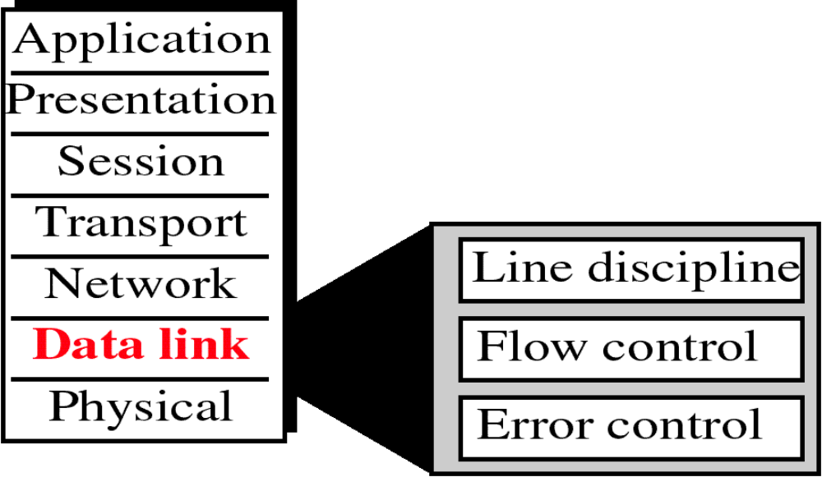
Data Link Layer

Slide 3
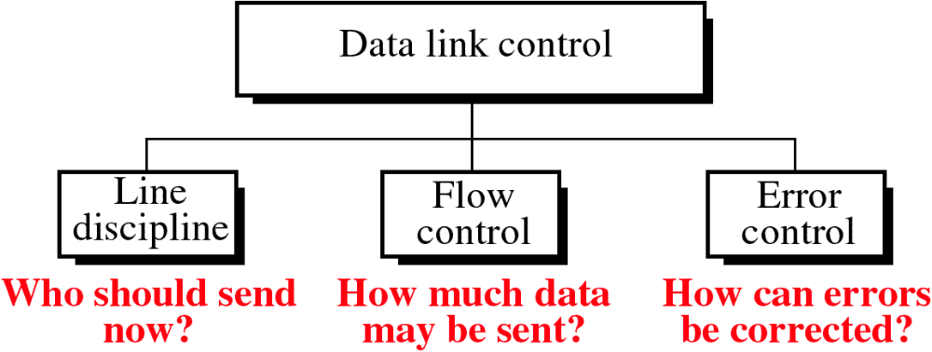

Slide 4
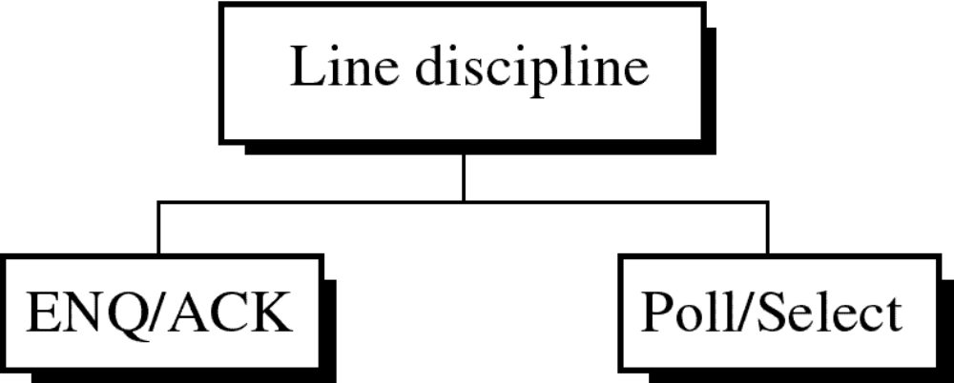

Slide 5

ENQ/ACK

Slide 6
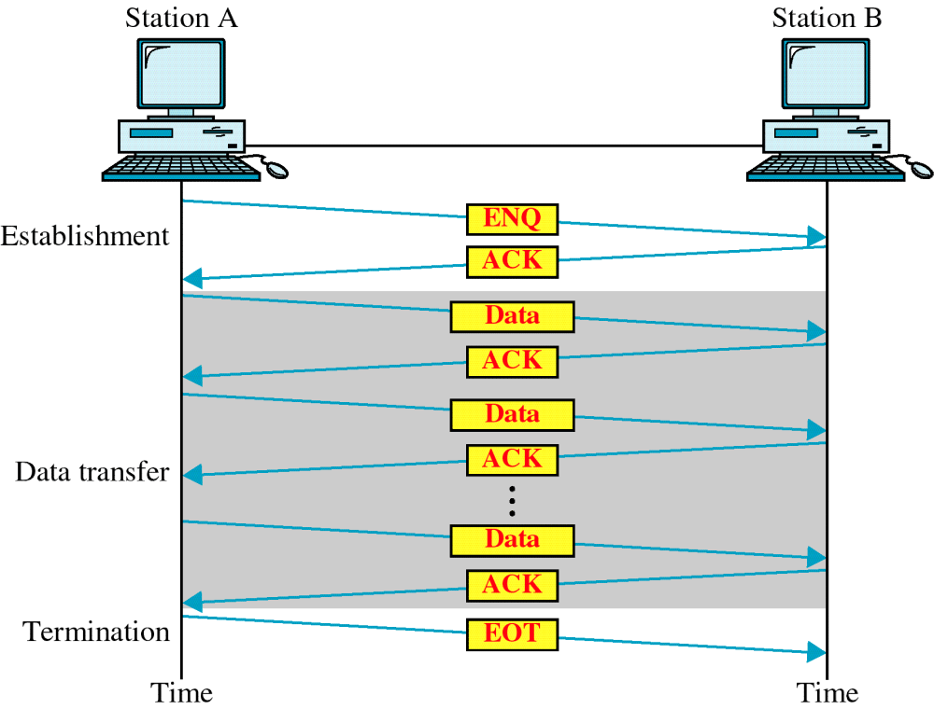
ENQ/ACK

Slide 7
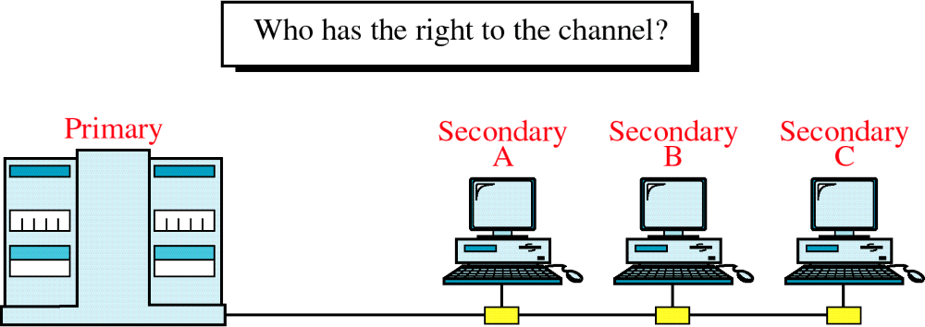
Multipoint Discipline

Slide 8
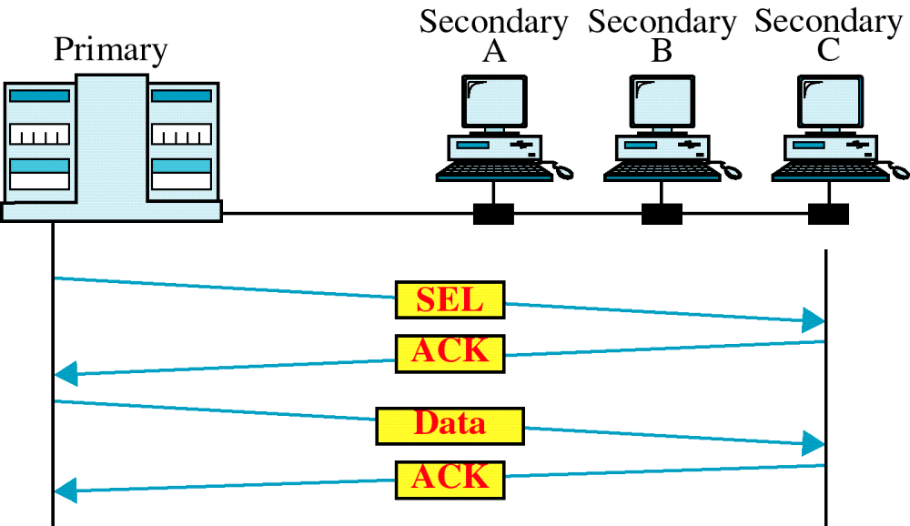
Select

Slide 9
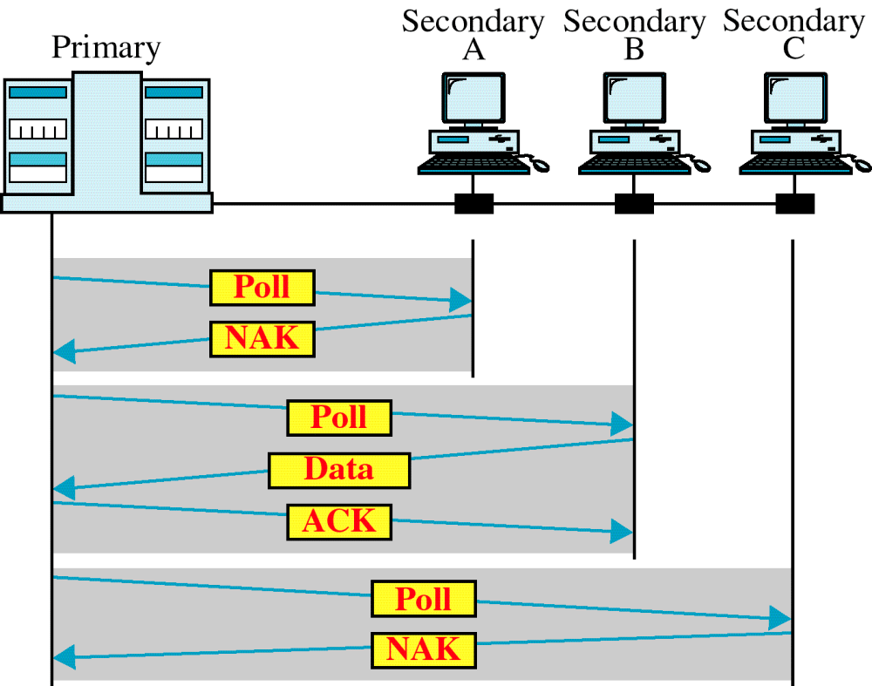
Poll

